Slide 1


IMDB
MOVIE ANALYSIS

Slide 2

CONTENT
01
PROJECT DESCRIPTION
02
APPROACH
03
TECH-STACK USED
04
INSIGHTS
05
RESULT

Slide 3




PROJECT DESCRIPTION
This project is about IMDB Movie Analysis. I was provided with the dataset having various columns of different IMDB Movies. I was required to provide a detailed report for the below data record mentioning the answers of the questions that follows:
Movie Genre Analysis
Movie Duration Analysis
Language Analysis
Director Analysis
Budget Analysis

Slide 4

APPROACH
01
02
03
04
DATASET
CLEANING
FUNCTION
GRAPH
I gone through dataset to know all the columns.
I started with cleaning the data set .
I applied functions and found the answer to each question
I plotted the graph wherever was required

Slide 5

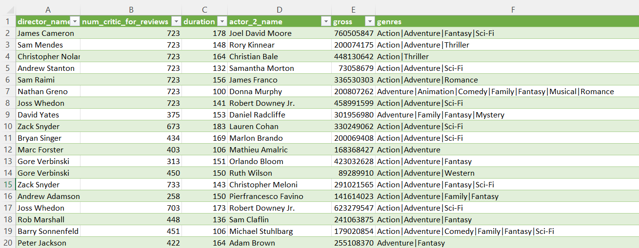
CLEANING THE DATA
https://docs.google.com/spreadsheets/d/1GHW0M2VqPRlTDKSleDtSgmGEIAcq7bvh/edit?usp=sharing&ouid=106942457558004201317&rtpof=true&sd=true
First, I deleted all the unwanted columns which were: color,
director_facebook_likes, actor_3_facebook_likes,
actor_1_facebook_likes, cast_total_facebook_likes,
facenumber_in_poster, plot_keywords, actor_2_facebook_likes,
aspect_ratio.
After that I removed all the rows with blank cells. For this first, I
selected whole table. After that, I selected go to special option
inside find & select menu. Inside the menu I selected blanks
option and all the blank cells were selected. Then I simply deleted
the rows which consists those blank cells.
Lastly, I removed all the duplicate rows.

Slide 6



TECH-STACK USED
The software used for the project is Microsoft Excel 365. It is used to run the functions and get answers of each question. It is also used to plot the graphs.

Slide 7
INSIGHTS

Slide 8
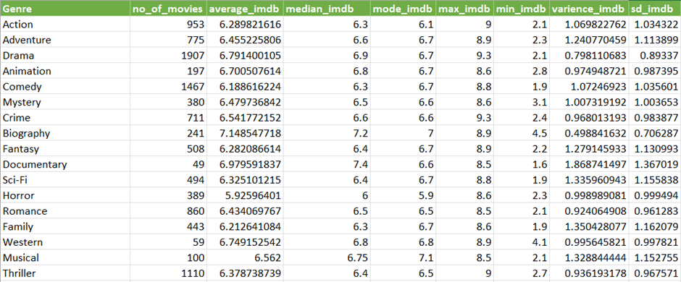
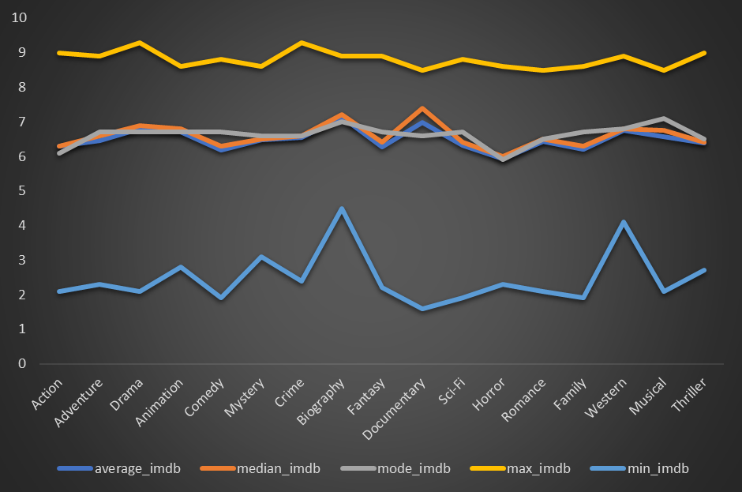
Movie Genre Analysis
https://docs.google.com/spreadsheets/d/1SwIZECZBaX83YIgE7s_fAiMSR1AVUm2f/edit?usp=sharing&ouid=106942457558004201317&rtpof=true&sd=true
=IF(ISNUMBER(SEARCH("|",Table_IMDB_Movies[@genres])),LEFT(Table_IMDB_Movies[@genres],SEARCH("|",Table_IMDB_Movies[@genres])-1),Table_IMDB_Movies[@genres])
=UNIQUE(V2:V3768)
=COUNTIF(F$2:F$3768,"*" & X2 & "*")
=AVERAGEIF(F$2:F$3768,"*" & X2 & "*",R$2:R$3768)
=MEDIAN(IF(ISNUMBER(SEARCH("*" & X2 & "*",F$2:F$3768)),R$2:R$3768))
=MODE(IF(ISNUMBER(SEARCH("*" & X2 & "*",F$2:F$3768)),R$2:R$3768))
=MAXIFS(R$2:R$3768,F$2:F$3768,"*" & X2 & "*")
=MINIFS(R$2:R$3768,F$2:F$3768,"*" & X2 & "*")
=VAR(IF(ISNUMBER(SEARCH("*" & X2 & "*",F$2:F$3768)),R$2:R$3768))
=STDEV(IF(ISNUMBER(SEARCH("*" & X2 & "*",F$2:F$3768)),R$2:R$3768))

Slide 9
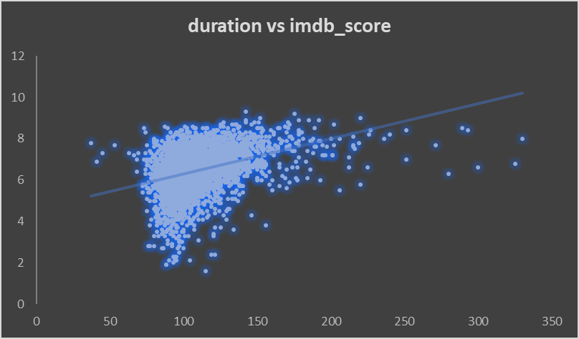

Movie Duration Analysis
https://docs.google.com/spreadsheets/d/1a3f0MsCE5PHjF2Dn7WTYn9tZekDIO7F-/edit?usp=sharing&ouid=106942457558004201317&rtpof=true&sd=true
=AVERAGE(C2:C3768)
=MEDIAN(C2:C3768)
=STDEVA(C2:C3768)

Slide 10
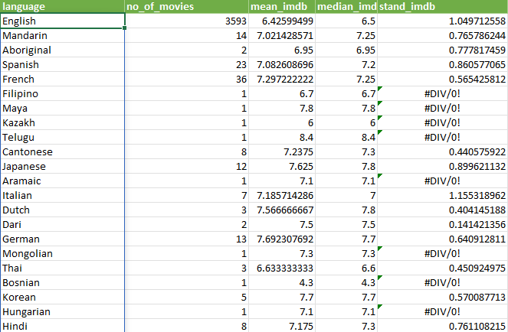
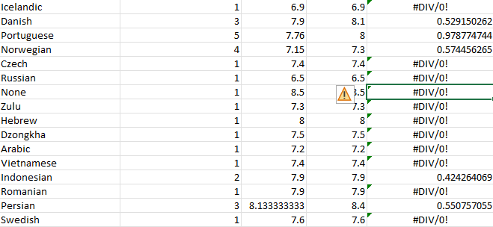
Language Analysis
https://docs.google.com/spreadsheets/d/1cmXAIl9iLqLw3nV1WU8y3tSw62Kij-Q8/edit?usp=sharing&ouid=106942457558004201317&rtpof=true&sd=true
=UNIQUE(M2:M3768)
=COUNTIF(M$2:M$3768,U2)
=AVERAGEIF(M$2:M$3768,U2,R$2:R$3768)
=MEDIAN(IF(M$2:M$3768=U2,R$2:R$3768))
=STDEV(IF(M$2:M$3768=U2,R$2:R$3768))

Slide 11
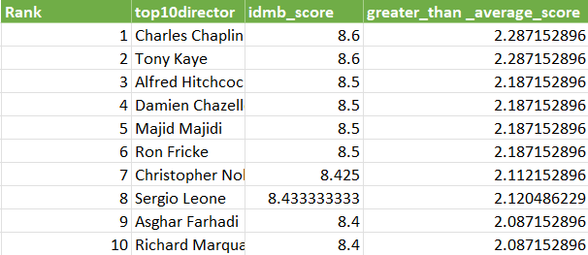
Director Analysis
https://docs.google.com/spreadsheets/d/11wWcvzX2oJnM-TvFBJpJpqaH7SDqdFCW/edit?usp=sharing&ouid=106942457558004201317&rtpof=true&sd=true
=UNIQUE(A2:A3768)
=AVERAGEIF(A$2:A$3768,V2,R$2:R$3768)
=PERCENTRANK.EXC(W$2:W$1694,W2)
=INDEX(SORTBY(V2:W1694,X2:X1694,-1,V2:V1694,1),SEQUENCE(10),{1,2})
=AB2-AVERAGE(W$2:W$1694)
To compare the scores of top directors to the overall distribution of scores I subtracted average imdb score from imdb score of the director.

Slide 12
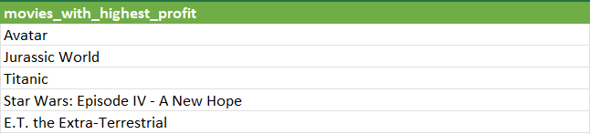
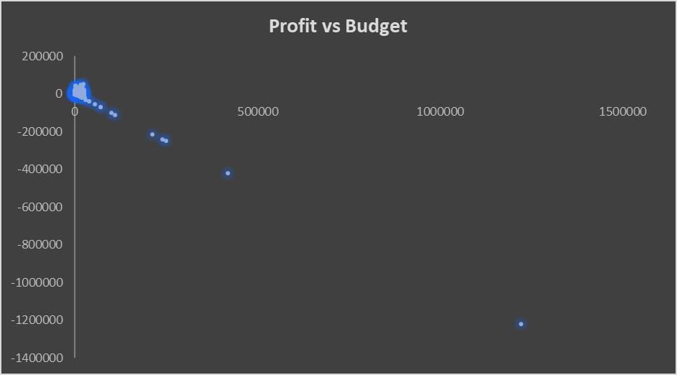
Budget Analysis
https://docs.google.com/spreadsheets/d/1IA7UlJ3YgYshWf3XKh6KGA8gbk76AqtE/edit?usp=sharing&ouid=106942457558004201317&rtpof=true&sd=true
=[@gross]-[@budget]
=CORREL(P2:P3768,E2:E3768)
=IF(T2:T3768=MAX(T2:T3768),H2:H3768,"")
=INDEX(SORTBY(H2:H3768,T2:T3768,-1),SEQUENCE(5))

Slide 13
RESULT
RESULT
Cleaning the data: Cleaned data consists of 3768 rows including title.
1. Movie Genre Analysis: The impact of genre is almost same on mean, median, mode movie ratings
2. Movie Duration Analysis:
3. Language Analysis: English is most popular language.
4. Director Analysis: Charles Chaplin is the director with highest imdb rating.
5. Budget Analysis: Avatar is the movie with highest profit.
Link of report: https://drive.google.com/file/d/1S0sTBbLZsb_OxKMknWzZEGy0yKiBpAqx/view?usp=sharing

Slide 14

THANK'S FOR WATCHING

